Slide 1
LHC-201 Fluid Line Routing Details
OpenAg, MIT Media Lab
By Eugene Zeleny
Oct 30th, 2019

Slide 2
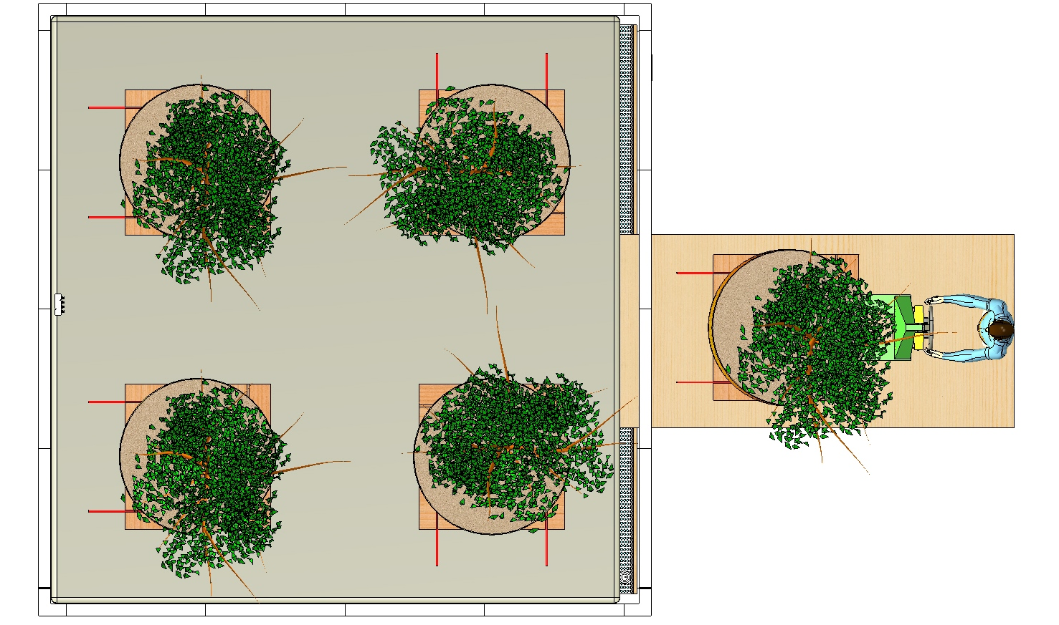
Tree pallet layout and suggested fluid line routing

Slide 3
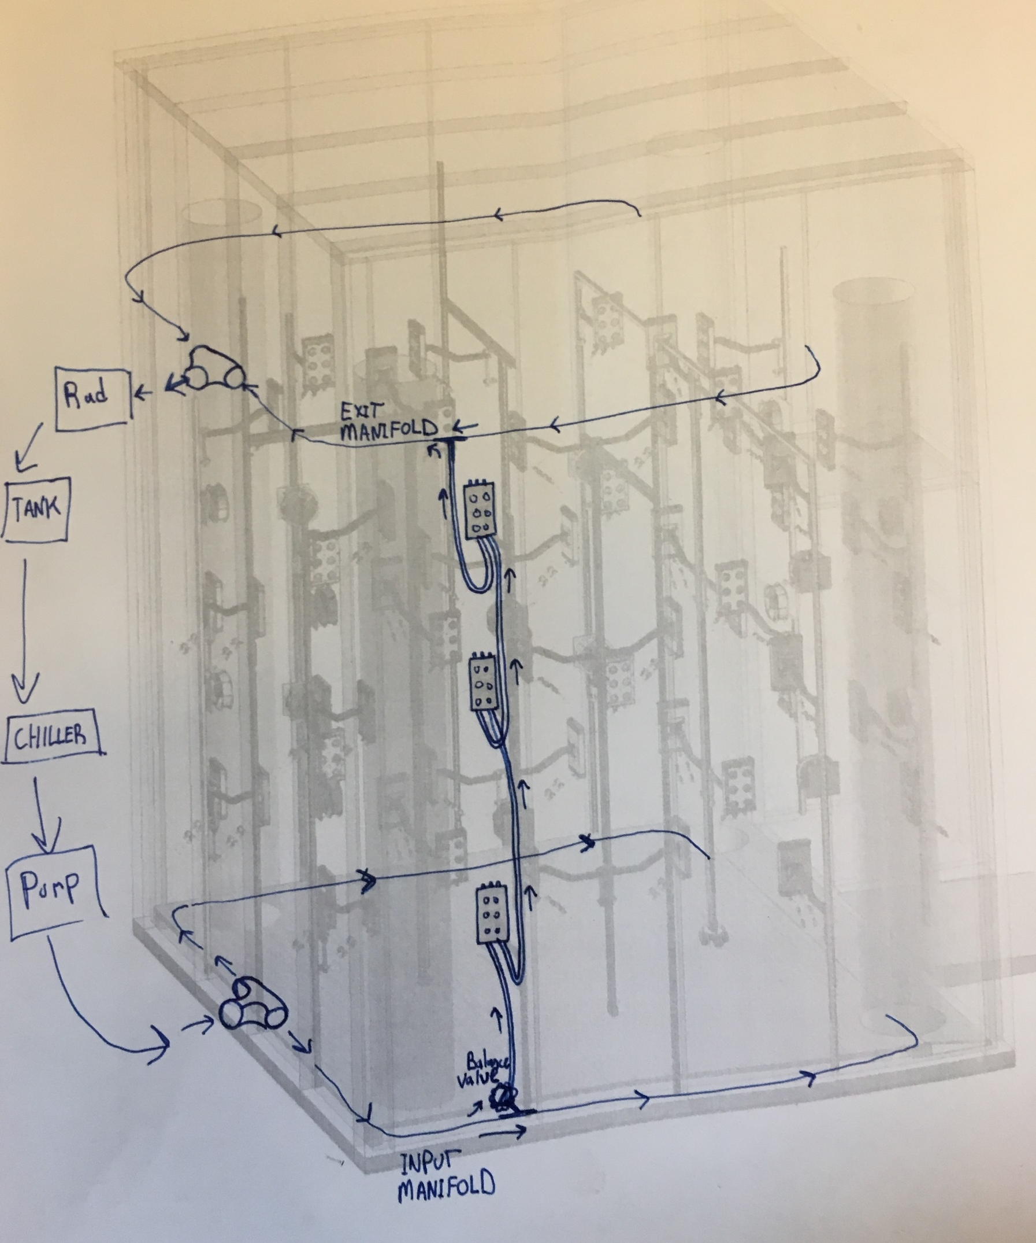

Slide 4
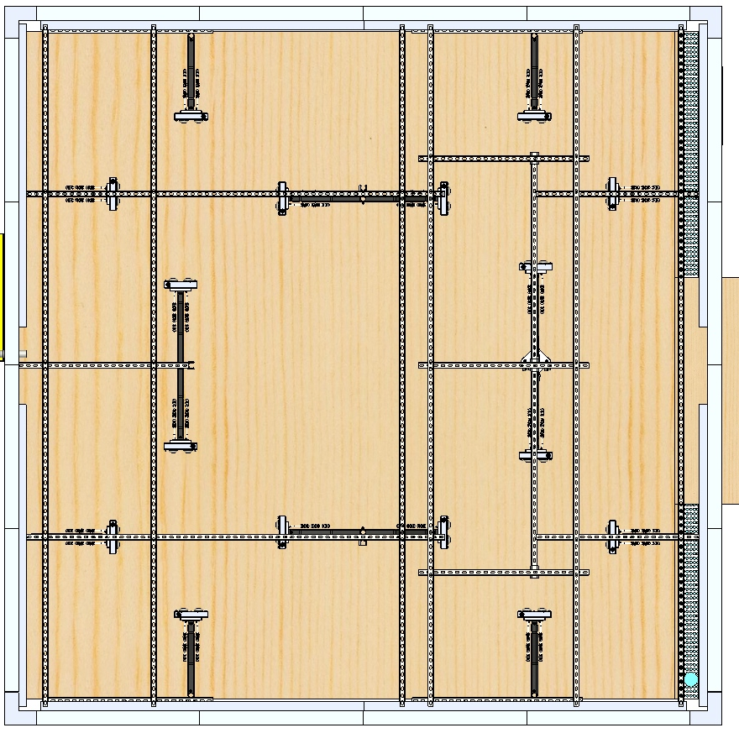
LED Enclosure Fluid Line Layout

